Slide 1


Intro Machine Learning 01 Overview
William Trimble, Amy Nussbaum
Winter 2023

Slide 2
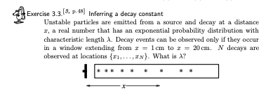
Administrivia
Week 1: read chapters 2 and 3 of Information Theory, Inference, and Learning Algorithms.
Today: whirlwind overview
Thursday: Bayesian estimation of continuous parameters
Homework 1, heavy on
prerequisites (calculus,
linear algebra, some
programming) is posted.

Slide 3

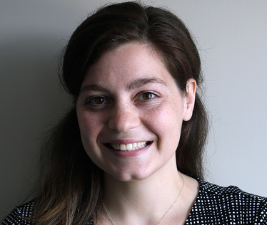

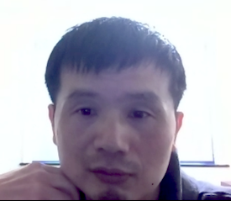
Who are we?
Instructors:
William Trimble wltrimbl@uchicago.edu
Amy Nussbaum anussbaum@uchicago.edu
TA’s:
JungHo Lee jungholee@uchicago.edu Graduate student in Statistics
Qiming Wang <qmwang@uchicago.edu> PhD student CS

Slide 4
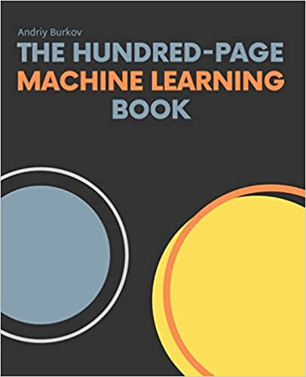
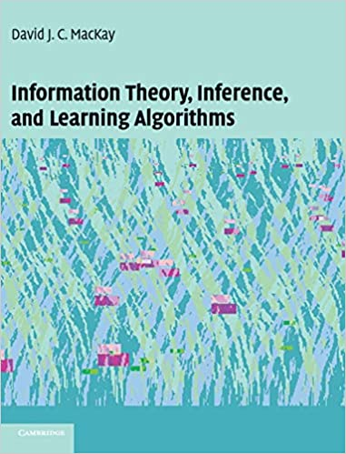
Andriy Burkov David MacKay

Slide 5
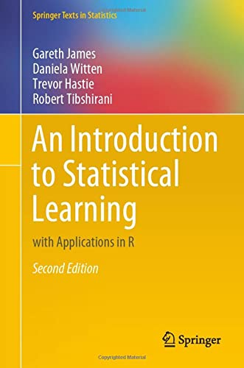
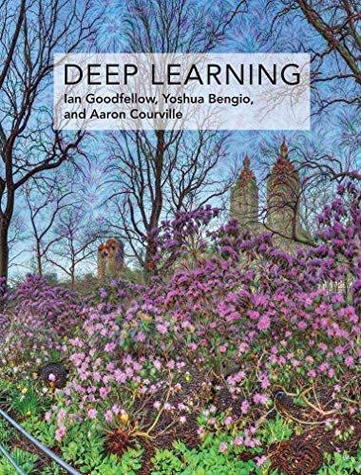
Gareth James Ian Goodfellow

Slide 6

Why is this funny?

Slide 7
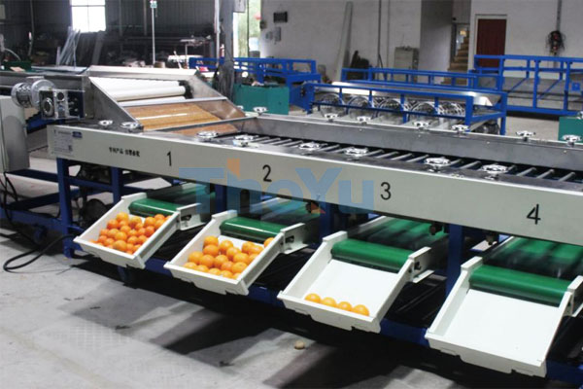
What is Machine Learning?
That part of data analysis concerned with automated decisionmaking
”Modeling” “parameter estimation” are related but narrower
Why data? If the task can be solved without data (say, by applying thresholds) you don’t need ML
This machine does not learn

Slide 8
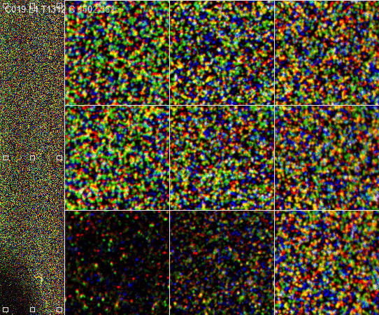
So-called NGS sequencing data: one of the data firehoses

Slide 9
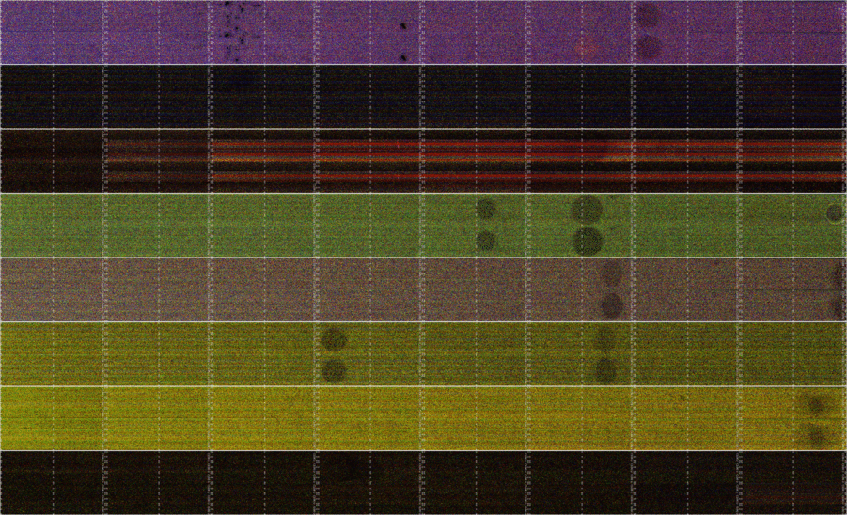

Slide 10
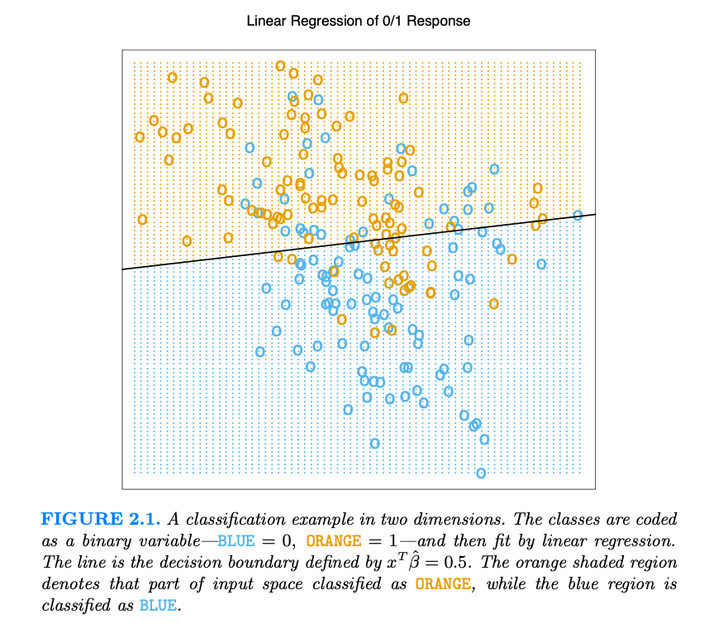
Hastie, ESL, Ch 2

Slide 11
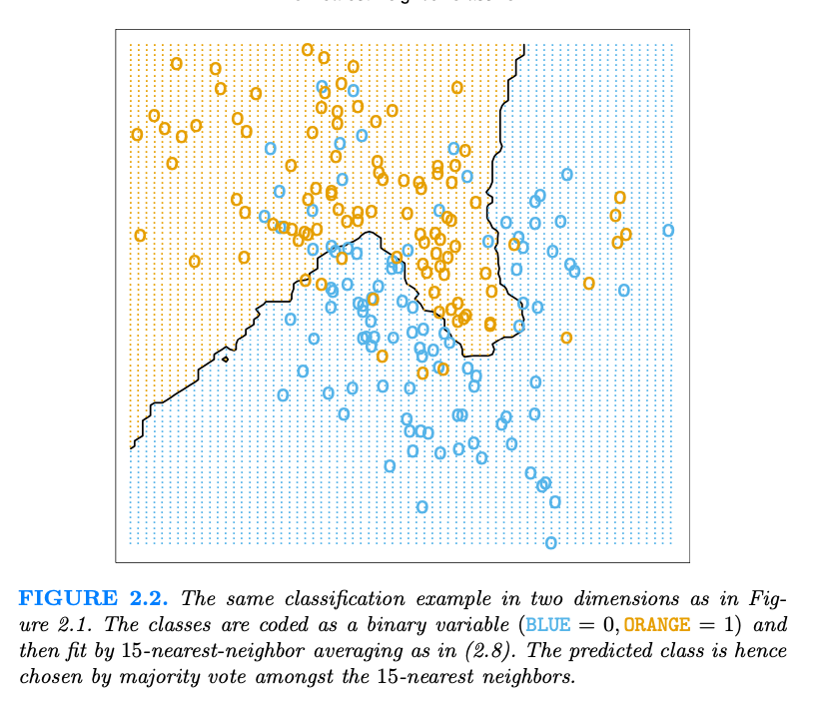
Hastie, ESL, Ch 2

Slide 12
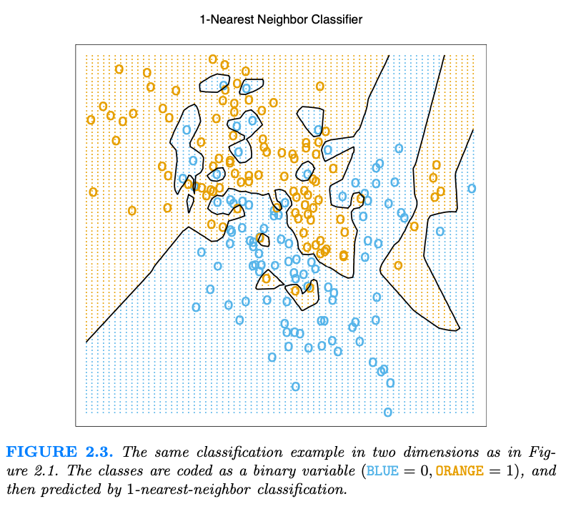
Hastie, ESL, Ch 2

Slide 13
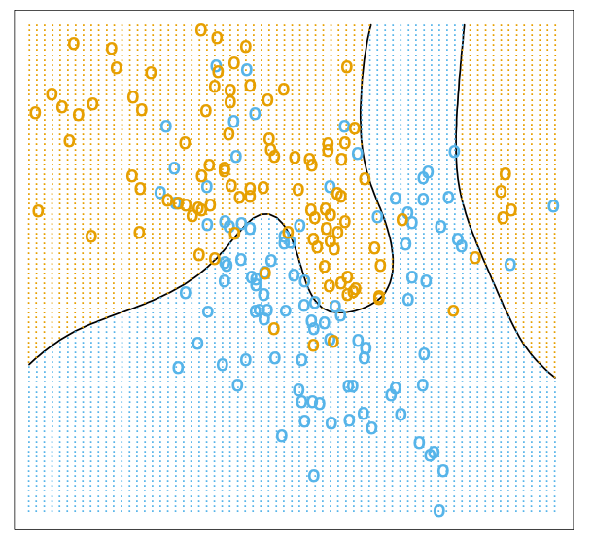
The optimal Bayes decision boundary for the simulation example. Since the generating density is known for each class, this boundary can be calculated exactly.
Hastie, ESL, Ch 2

Slide 14
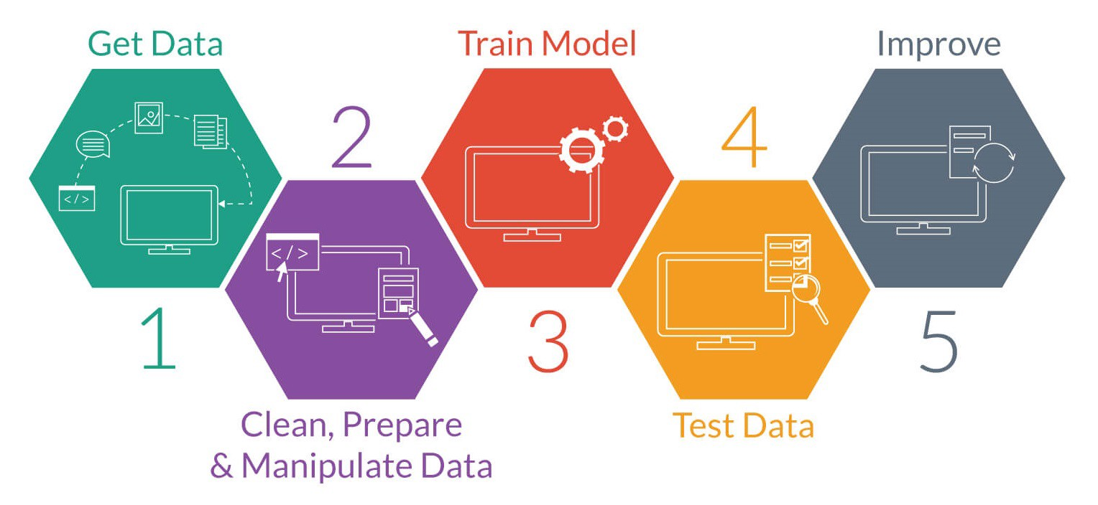
The steps
Define the Task (input space and output space)
Data preprocessing (feature extraction & wrangling)
Measure performance
Train (or “learn”) the model
Victory ?!?

Slide 15
Task
Regression -- predicting some values of interest
Imputation of missing values
Classification – put data points into categories
Classification with missing inputs
collection of many classifiers, each for different set of missing data items?
generate a probability density for everything, marginalize over missing inputs
Transcription –encode symbols in an image or audio waveform
Structured output – answer very specific questions, like map annotation, write computer programs or captions
Anomaly detection – fraud detection, for instance
Noise detection / removal / error correction
Density estimation; fitting (parameters of interest)
Goodfellow, Ch 5

Slide 16
Task
Regression -- predicting some values of interest
Imputation of missing values
Classification – put data points into categories
Classification with missing inputs
collection of many classifiers, each for different set of missing data items?
generate a probability density for everything, marginalize over missing inputs
Transcription –encode symbols in an image or audio waveform
Structured output – answer very specific questions, like map annotation, write computer programs or captions
Anomaly detection – fraud detection, for instance
Noise detection / removal / error correction
Density estimation; fitting (parameters of interest); matching
Advertising, prediction
Medical diagnosis
Recommender algorithms
Machine translation
generation of textures, waveforms
Fake news; security applications
Geodesy; remote sensing; astronomy
fingerprints, DNA
Goodfellow, Ch 5

Slide 17
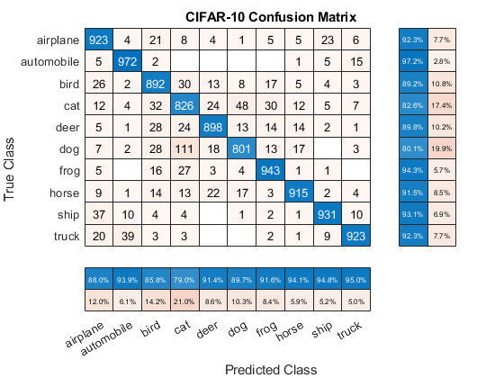
Measure Performance
How well does the model answer our question?
Measure “accuracy”
Maybe fold in “costs for different sorts of errors
to guide decision thresholds; manage our training
in light of expected frequencies
Measure accuracy on the training set and on data not used for training “testing” or “holdout” sets.
Calculus helps us for continuous variables / continuous inputs
Brute force or Markov-chain Monte Carlo for discrete variables
Space of parameters is often exceedingly large and complex; we usually have to resort to randomized algorithms and truncated representations.
Goodfellow, Ch 5

Slide 18
Train (or “learn”) the model
Unsupervised algorithms usually try to distill the empirical probability density into something that can be succinctly communicated.
This the essence of compression
Clustering, finding groups of similar items, recommendation
Dimension reduction, embedding, big data visualization
Supervised algorithms: training data with gold-standard labels or desired outcomes
Semi-supervised: we can only afford to label some of the data, but have access to a larger population of unlabeled data for modeling its density
Goodfellow, Ch 5

Slide 19
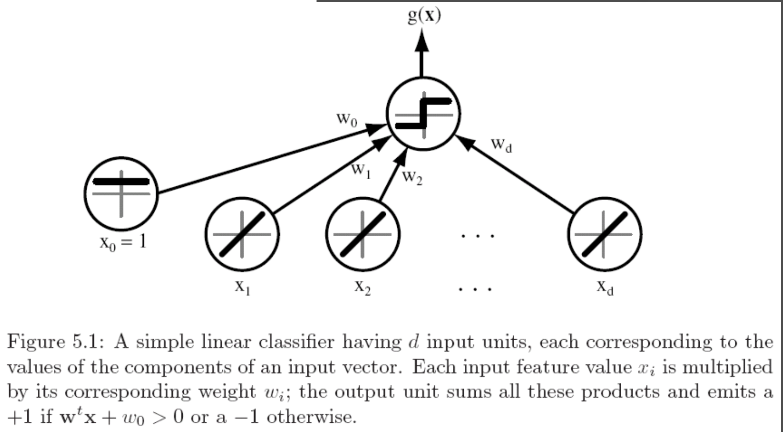
Linear classifier
Duda, Pattern Classification

Slide 20
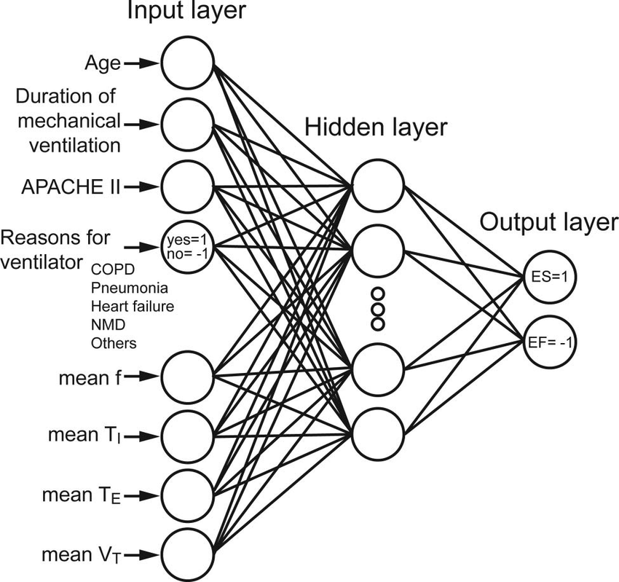
Neural networks
Linear classifiers
+nonlinear sauce
= arbitrary function machines
Kuo et al. doi:10.4187/respcare.03648

Slide 21
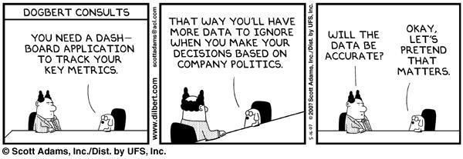

Slide 22
New data
Black box
Predictions/
decisions

Slide 23
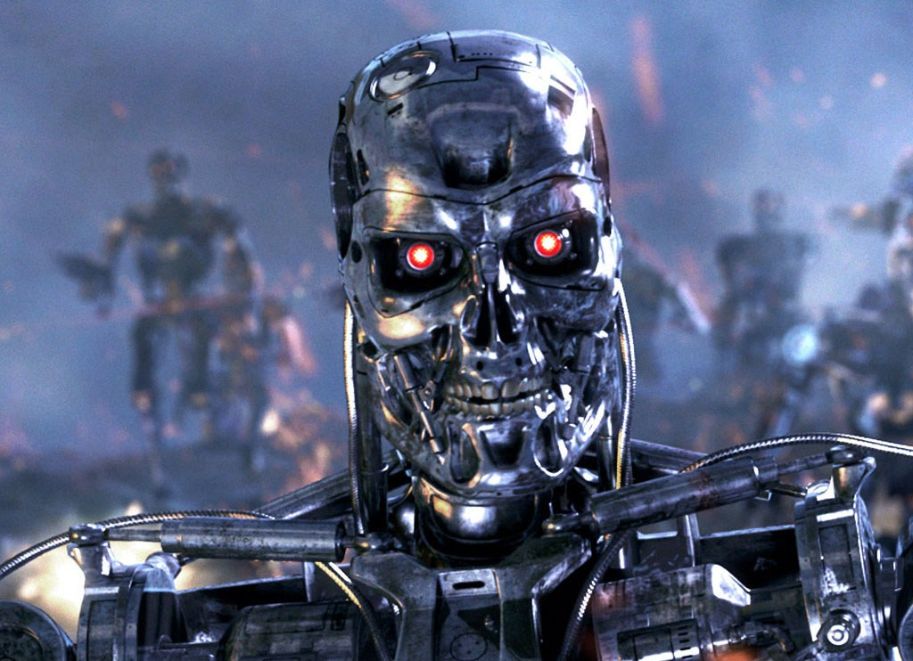
Training data
ML algorithm
New data
Black box
Predictions/
decisions

Slide 24
Unlabeled data
Training data
ML algorithm
New data
Black box
Predictions/
decisions

Slide 25
Training data
ML algorithm
Explanations?
New data
Black box
Predictions/
decisions

Slide 26
Training data
ML algorithm
New data
Black box
Predictions/
decisions

Slide 27
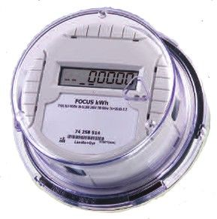
Where do the costs lie?
Training data
ML algorithm
New data
Black box
Predictions/
decisions

Slide 28
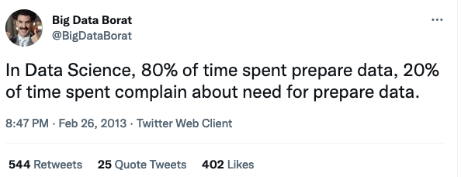
Where do the costs lie?
Most of the cost is in getting worthwhile, relevant, usable training data.

Slide 29
Unlabeled data
Training data
ML algorithm
Explanations?
New data
Black box
Predictions/
decisions

Slide 30
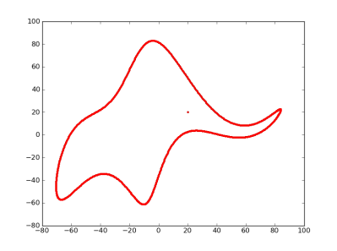
With an ocean of free parameters, we can fit anything.
“with four parameters I can fit an elephant, and with five I can make him wiggle his trunk.”
– John von Neumann, as told to Enrico Fermi, as told by Freeman Dyson.
doi://10.1038/427297a
doi://10.1119/1.3254017

Slide 31
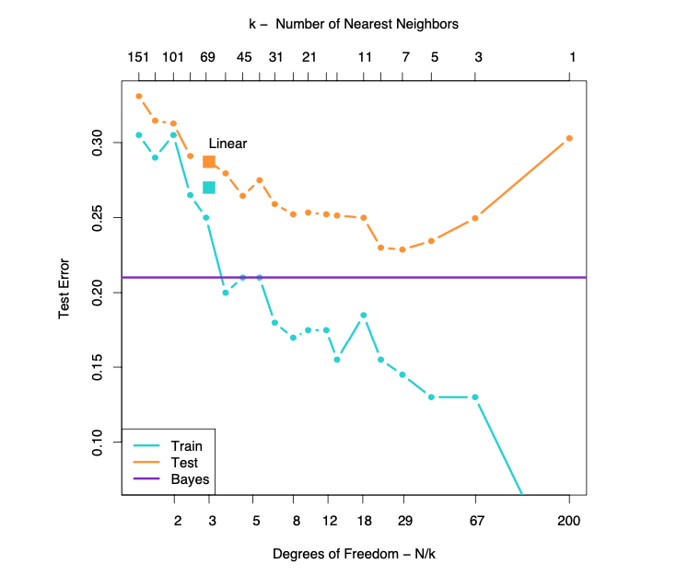
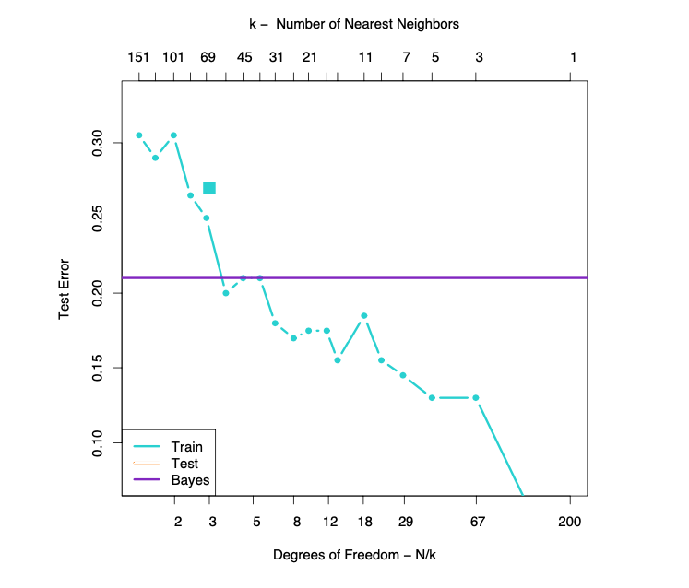
Model complexity
Hastie, ESL, Ch 2

Slide 32
Generalization error
Hastie, ESL, Ch 2

Slide 33
Generalization error
Underfitting
Overfitting
Generalization error
Model complexity
Hastie, ESL, Ch 2

Slide 34
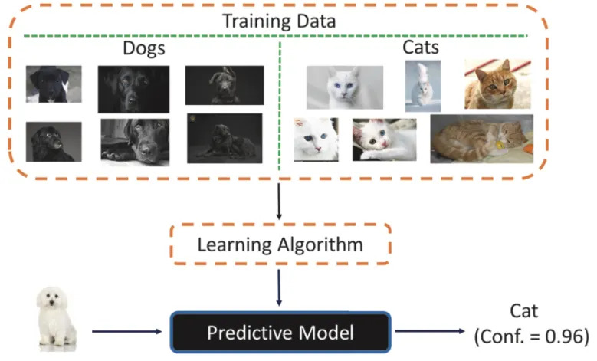

Slide 35
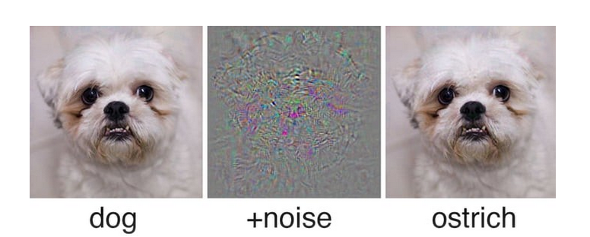
ML systems don’t make mistakes the way that we do…
Maliciously constructed inputs can lead machine-decision makers astray

Slide 36
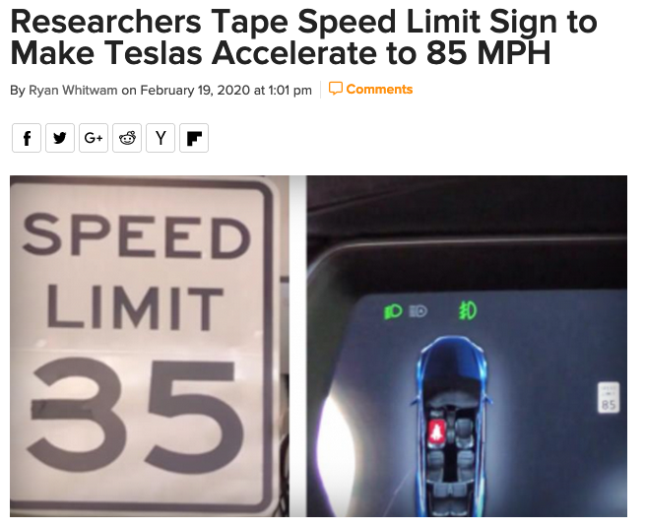


Data, ML systems are tools that benefit some more than others

Slide 37
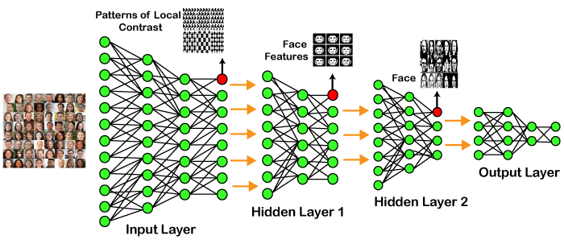
What is good?
We can simulate things, right? What is a good algorithm / model / procedure?

Slide 38
What is good?
We can simulate things, right? What is a good algorithm / model / procedure?
Desired properties: generalize to data that perhaps aren’t like the training data ???
Desired properties: get good accuracy with comparatively little training data. !!!

Slide 39

The toolbox
The toolbox has different kinds of things.
“Traditional” algorithms that work (E-M, backpropagation, simulated annealing)
Learning procedures sometimes correspond to Bayesian inference. Often can only draw samples via Markov Chain Monte Carlo sampling.
“Nonparametric” methods that look a little like adhockery
Optimization, stochastic gradient descent

Slide 40


Slide 41
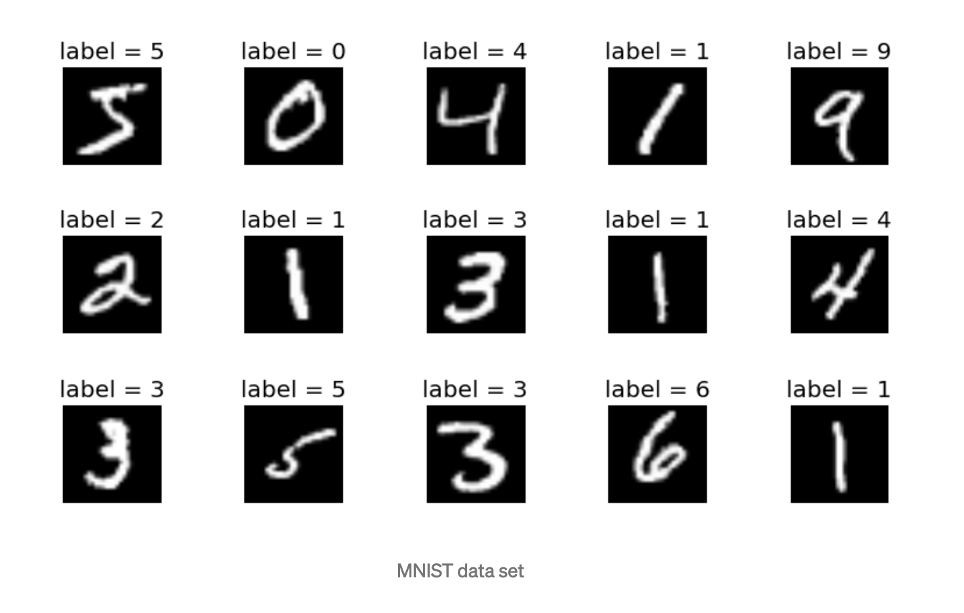
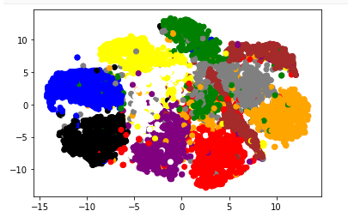
The Plan
Linear classifiers
Nonparametric methods, clustering
Optimization
Evaluation, choosing algorithm
Overfitting and regularization
Neural networks
Intro Deep Learning
I will shoot for half math, half hacking

Slide 42
Administrivia
Expect turnover / attrition first week.
Homework (70%).
• Final project(30%).

Slide 43
HW1

